Slide 1
Index structures/files
Dense, Sparse, Primary, Secondary,
Clustered, Un-clustered files
I/O Cost based Analysis model
Notes:
1

Slide 2
Indexing
Can we do anything else to improve query performance other than selecting a good file organization?
Yes, the answer lies in indexing
Index - a data structure that allows the DBMS to locate particular records in a file more quickly
Very similar to the index at the end of a book to locate various topics covered in the book
Types of Index
Primary index – one primary index per file
Clustering index – one clustering index per file – data file is ordered on a non-key field and the index file is built on that non-key field
Secondary index – many secondary indexes per file
Sparse index – has only some of the search key values in the file
Dense index – has an index corresponding to every search key value in the file

Slide 3
Introduction
Issue
How to get required records efficiently
Example
SELECT * from R;
SELECT * from R where A=10;
Index is a data structure that lets us find quickly records with given ‘search key’ value without having to look at more than a fraction of all records
An index takes a value for search key and finds records with the matching value

Slide 4
An index file takes much less space than the corresponding data file
An index is especially advantageous if it can fit in memory
A record can be found with only one disk I/O
An index itself can be too large to fit in the memory
Multi-level indexes
Only part of index in memory

Slide 5
Purposes of Data Indexing
What is Data Indexing?
Why is it important?

Slide 6
How DBMS Accesses Data?
The operations read, modify, update, and delete are used to access data from database.
DBMS must first transfer the data temporarily to a buffer in main memory.
Data is then transferred between disk and main memory into units called blocks.

Slide 7
Time Factors
The transferring of data into blocks is a very slow operation.
Accessing data is determined by the physical storage device being used.

Slide 8
More Time Factors
Querying data out of a database requires more time.
DBMS must search among the blocks of the database file to look for matching tuples.

Slide 9
Purpose of Data Indexing
It is a data structure that is added to a file to provide faster access to the data.
It reduces the number of blocks that the DBMS has to check.

Slide 10
Properties of Data Index
It contains a search key and a pointer.
Search key - an attribute or set of attributes that is used to look up the records in a file.
Pointer - contains the address of where the data is stored in memory.
It can be compared to the card catalog system used in public libraries of the past.

Slide 11
Two Types of Indices
Ordered index (Primary index or clustering index) – which is used to access data sorted by order of values.
Hash index (secondary index or non-clustering index ) - used to access data that is distributed uniformly across a range of buckets.

Slide 12
Index
Mechanism for efficiently locating row(s) without having to scan entire table
Based on a search key: rows having a particular value for the search key attributes can be quickly located
Don’t confuse candidate key with search key:
Candidate key: set of attributes; guarantees uniqueness
Search key: sequence of attributes; does not guarantee uniqueness –just used for search

Slide 13
Indexes
Sometimes need to retrieve records by the values in one or more fields, e.g.,
Find all students in the “CS” department
Find all students with a cgpa > 8
An index on a file is a:
Disk-based data structure
Speeds up selections on the search key fields for the index.
Any subset of the fields of a relation can be index search key
Search key is not the same as (candidate) key
(e.g. doesn’t have to be unique).
An index
Contains a collection of index and data entries
Supports efficient retrieval of all records with a given search key value k.

Slide 14
Basic Concepts
Indexing is used to speed up access to desired data.
E.g. author catalog in library
A search key is an attribute or set of attributes used to look up records in a file. Unrelated to keys in the db schema.
An index file consists of records called index entries.
An index entry for key k may consist of
An actual data record (with search key value k)
A pair (k, rid) where rid is a pointer to the actual data record
A pair (k, bid) where bid is a pointer to a bucket of record pointers
Index files are typically much smaller than the original file if the actual data records are in a separate file.
If the index contains the data records, there is a single file with a special organization.

Slide 15
Types of index structures
Simple indexes on sorted files
Usually, created on primary key
Secondary indexes on unsorted files
Clustered indexes
B-trees, a commonly used structure
Hash table

Slide 16
Types of Indices
The records in a file may be unordered or ordered sequentially by some search key.
A file whose records are unordered is called a heap file.
If an index contains the actual data records or the records are sorted by search key in a separate file, the index is called clustering (otherwise non-clustering).
In an ordered index, index entries are sorted on the search key value. Other index structures include trees and hash tables.

Slide 17
Primary Indexes (On sorted files)
The simplest structure
The data file is a sequential file
The data file is sorted on a key, usually primary key
The index file consists of <key,pointer> pairs
Types of indexes
Dense: every record has an entry in the index
Sparse: only some of the data records have entries in the index

Slide 18
Types of Single-Level Indexes
Primary Index
Defined on an ordered data file
The data file is ordered on a key field
Includes one index entry for each block in the data file; the index entry has the key field value for the first record in the block, which is called the block anchor
A similar scheme can use the last record in a block.
A primary index is a nondense (sparse) index, since it includes an entry for each disk block of the data file and the keys of its anchor record rather than for every search value.

Slide 19
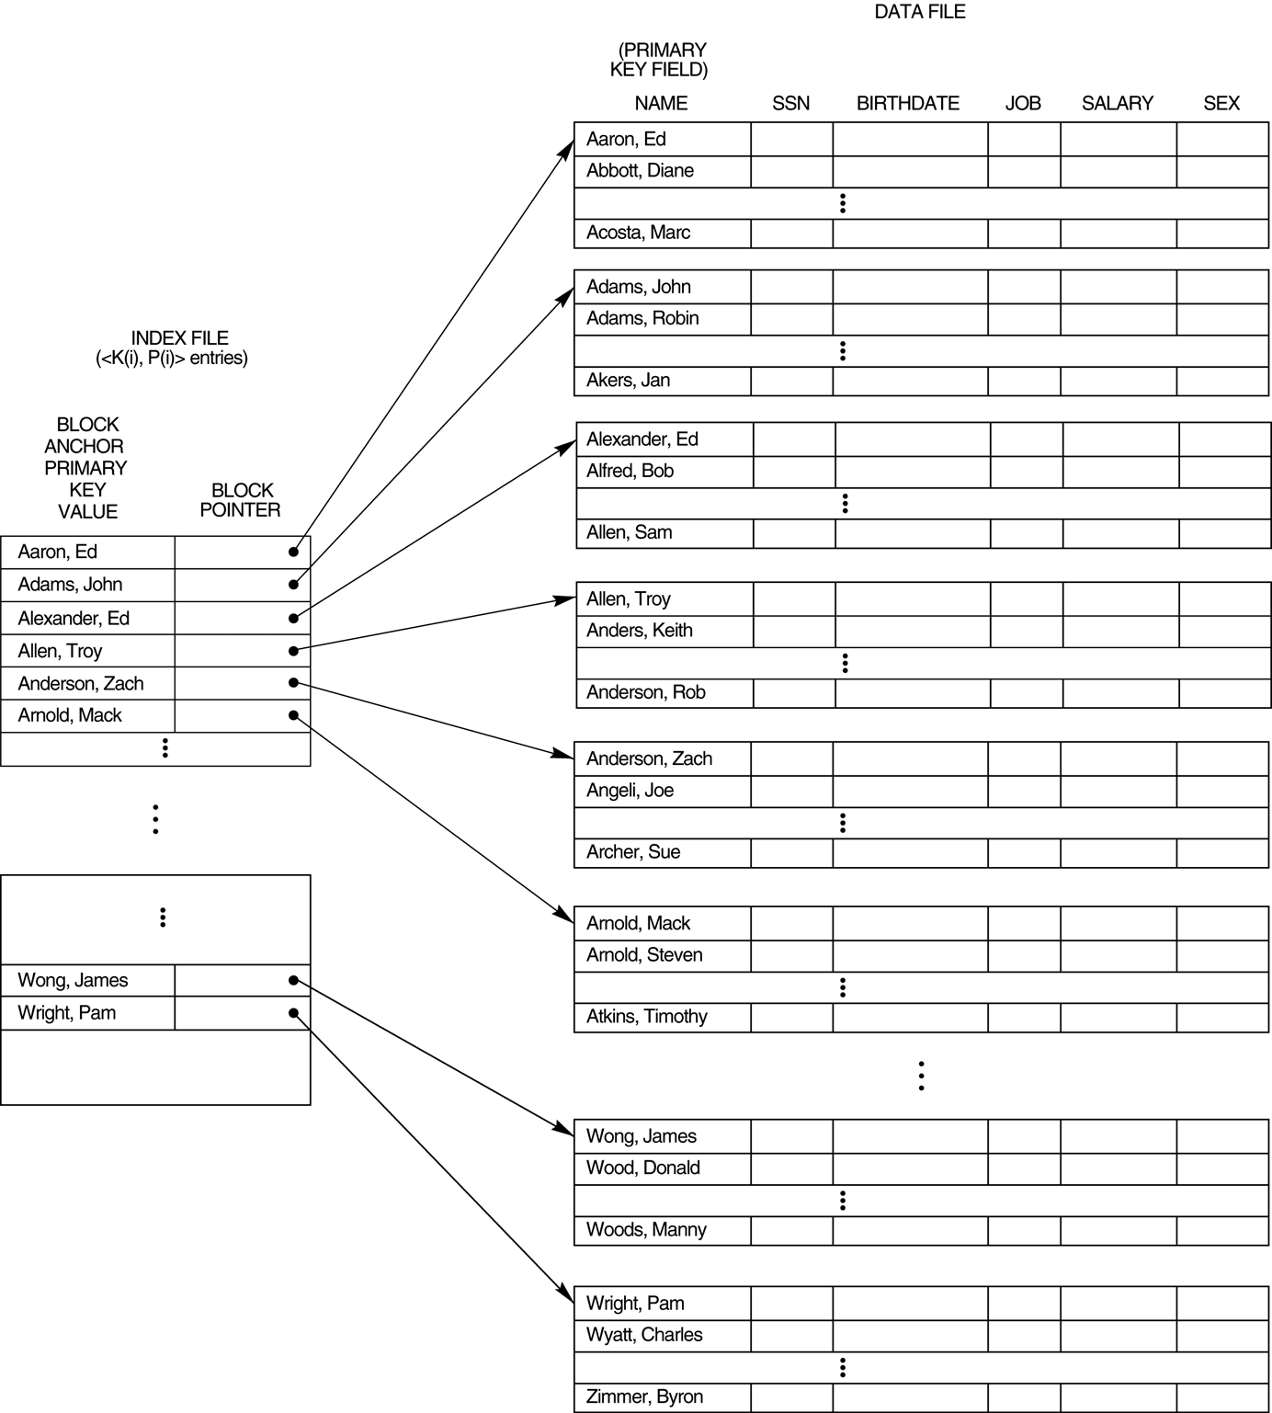
Primary index on the ordering key field of the file

Slide 20
Index Structure
Contains:
Index entries
Can contain the data tuple itself (index and table are integrated in this case); or
Search key value and a pointer to a row having that value; table stored separately in this case – unintegrated index
Location mechanism
Algorithm + data structure for locating an index entry with a given search key value
Index entries are stored in accordance with the search key value
Entries with the same search key value are stored together (hash, B- tree)
Entries may be sorted on search key value (B-tree)

Slide 21
Index Structure
S
Search key
value
Location Mechanism
Location mechanism
facilitates finding
index entry for S
S
Index entries
Once index entry is found, the row can be directly accessed
S, …….

Slide 22
Dense indexes
Every key from the data file is represented
Entries are in the same order as that of the file
Binary search can be used to find the required <key, pointer>
No.of blocks searched ‘log n’ instead of n/2 on an average

Slide 23
Example: 1,000,000 tuples, 10 tuples/4096 byte block, key field 30 bytes, pointer 8 bytes
Data file takes 400MB space
Index file will take 10,000 blocks with100 entries/block
Search will involve at most log10000 = 13 blocks in MM
Memory can also be optimized by keeping only most searched blocks in memory
Hence a record can be retrieved with less than 14 disk I/Os

Slide 24
Sparse indexes
Useful if dense index is too large
Uses less space at the cost of possibly more time to search
Generally a record, usually the first, per block is represented
Sparse index for previous example would take only 1000 blocks, 4MB
But, it can not give quick answer to query ‘does there exist a record with key value K?”
It requires one disk I/O with searching in the block
Search K: find entry with largest key ≤ K

Slide 25
Sparse Vs Dense Index
Dense index: index entry for each data record
Unclustered index must be dense
Clustered index need not be dense
Sparse index: index entry for each block of data file

Slide 26
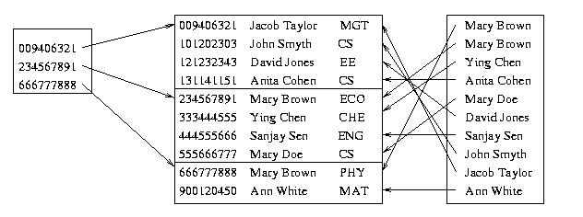
Sparse Vs. Dense Index
Id Name Dept
Sparse,
clustered
index sorted
on Id
data file sorted
on Id
Dense,
unclustered
index sorted
on Name

Slide 27
Clustered vs. Unclustered Index
Clustered (main/primary) index: index entries and rows are ordered in the same way
An integrated storage structure is always clustered
There can be at most one clustered index on a table
Unclustered (secondary) index: index entries and rows are not sorted on the same search key
There can be many secondary indices on a table

Slide 28
Clustering and Non-clustering
Non-clustering indices have to be dense.
Indices offer substantial benefits when searching for records.
When a file is modified, every index on the file must be updated. Updating indices imposes overhead on database modification.
Sequential scan using clustering index is efficient, but a sequential scan using a non-clustering index is expensive – each record access may fetch a new block from disk.
Block fetch requires about 5 to 10 micro seconds, versus about 100 nanoseconds for memory access

Slide 29
Clustered Index
Good for range searches
Use location mechanism to locate index entry at start of range
This locates first data record.
Subsequent data records are contiguous if index is clustered (not so if unclustered)
Minimizes page transfers and maximizes likelihood of cache hits

Slide 30
Sparse Index Files
A clustering index may be sparse.
Index records for only some search-key values.
To locate a record with search-key value k we:
Find index record with largest search-key value < k
Search file sequentially starting at the record to which the index record points
Less space and less maintenance overhead for insertions and deletions.
Generally slower than dense index for locating records.
Good tradeoff: sparse index with an index entry for every block in file, corresponding to least search-key value in the block.

Slide 31
Types of Single-Level Indexes
Secondary Index
A secondary index provides a secondary means of accessing a file for which some primary access already exists.
The secondary index may be on a field which is a candidate key and has a unique value in every record, or a nonkey with duplicate values.
The index is an ordered file with two fields.
The first field is of the same data type as some nonordering field of the data file that is an indexing field.
The second field is either a block pointer or a record pointer. There can be many secondary indexes (and hence, indexing fields) for the same file.
Includes one entry for each record in the data file; hence, it is a dense index

Slide 32
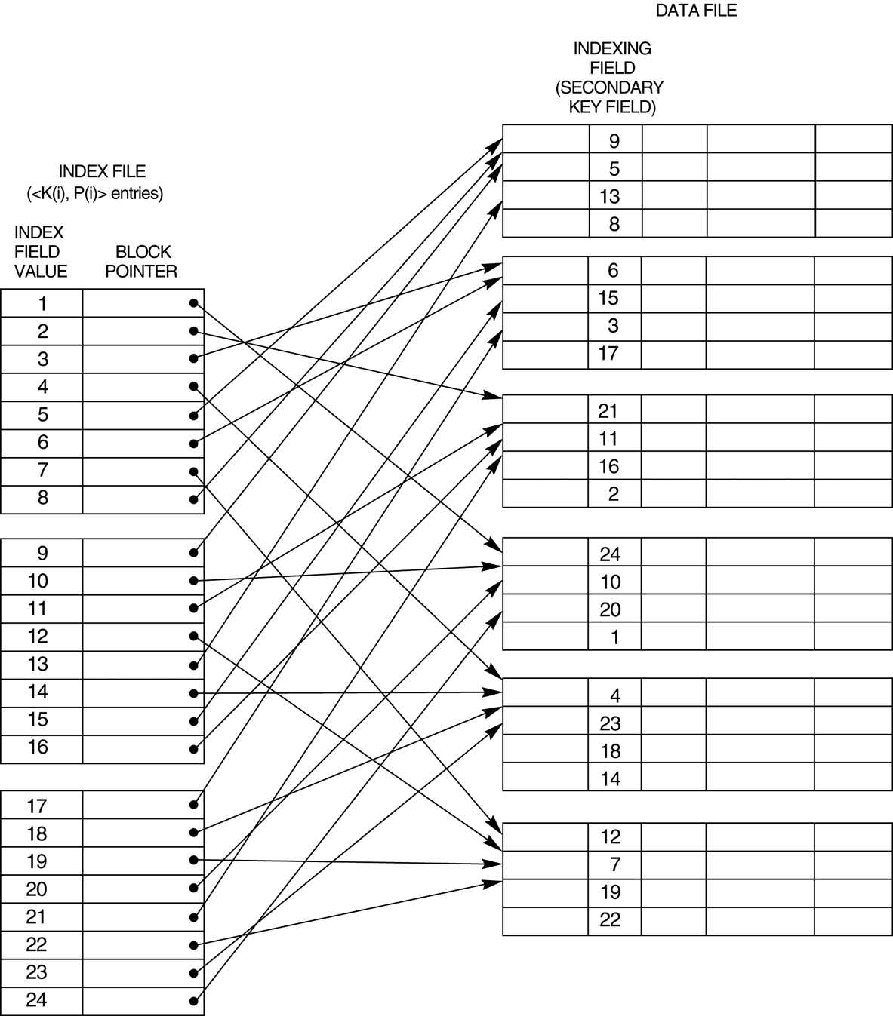
A dense secondary index (with block pointers) on a nonordering key field of a file.

Slide 33
Secondary indexes
SELECT name, address
FROM MovieStar
WHERE birthdate=DATE ‘1952-01-01’
CREATE INDEX BDIndex ON MovieStar(birthdate);
Secondary indexes are always ‘dense’
Second level index could be ‘sparse’
Secondary indexes are usually with duplicates

Slide 34
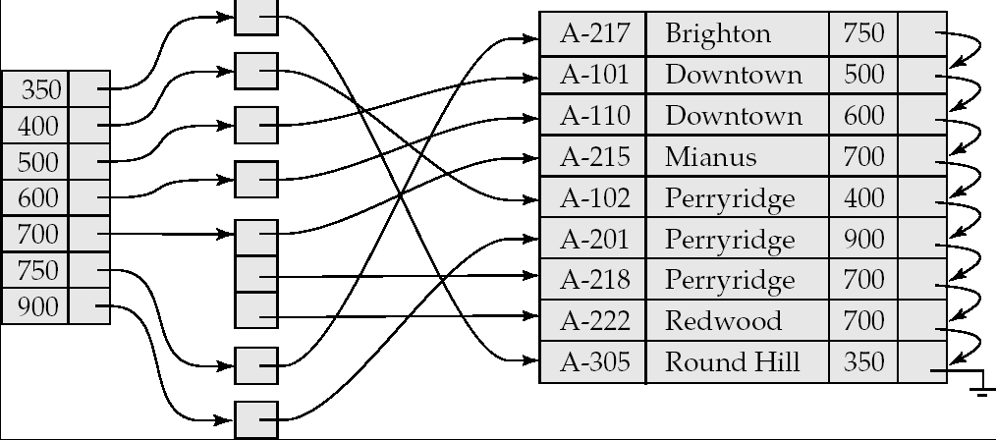
Secondary Indices Example
Secondary index on balance field of account
Index record points to a bucket that contains pointers to all the actual records with that particular search-key value.

Slide 35
20
40
Secondary index
10
10
20
20
10
20
50
30
20
30
40
50
10
50
60
20

Slide 36
Pointers in one index block may refer to multiple data blocks
Results in more number of Disk I/Os
Unavoidable problem
Using ‘bucket file’ between index file and data file
Single entry <k,p> for each value ‘k’ where p points to location in bucket file containing all other pointers of records with value ‘k’
Avoids wastage of space due to multiple storage of same value ‘k’

Slide 37
Definition of Bucket
Bucket - another form of a storage unit that can store one or more records of information.
Buckets are used if the search key value cannot form a candidate key, or if the file is not stored in search key order.

Slide 38
20
40
10
20
30
40
10
20
50
30
50
60
10
50
60
20
Index file
Bucket file
Data file

Slide 39
Application of ‘bucket file’
It can help answer queries efficiently using intersection of pointer sets
Example
SELECT title
FROM Movie
WHERE StudioName=‘Disney’ AND year=1995;
This reduces number of Disk I/Os

Slide 40
Movie Tuples
Buckets for studio
Buckets for year
Disney
1995
Studio index
Year index

Slide 41
Multi-level indexes
When an index is too large with even binary search taking too many disk I/Os
Define second level index: index on index
This can continue to multi-level index structure
Second and higher level indexes must be sparse
Second level index in previous example would take only 10 blocks, 40KB
Search involves 2 disk I/Os and searching in the block

Slide 42
Multilevel Index
If an index does not fit in memory, access becomes expensive.
To reduce number of disk accesses to index records, treat the index kept on disk as a sequential file and construct a sparse index on it.
outer index – a sparse index on main index
inner index – the main index file
If even outer index is too large to fit in main memory, yet another level of index can be created, and so on.
Indices at all levels must be updated on insertion or deletion from the file.

Slide 43
Multilevel Index (Cont.)
outer index
inner index
Data
Block 0
Index
Block 0


Data
Block 1

Index
Block 1





Slide 44
Multi-level indexes
When an index is too large with even binary search taking too many disk I/Os
Define second level index: index on index
This can continue to multi-level index structure
Second and higher level indexes must be sparse
Second level index in previous example would take only 100 blocks, 400KB
Search involves 6 disk I/Os and searching in the block

Slide 45
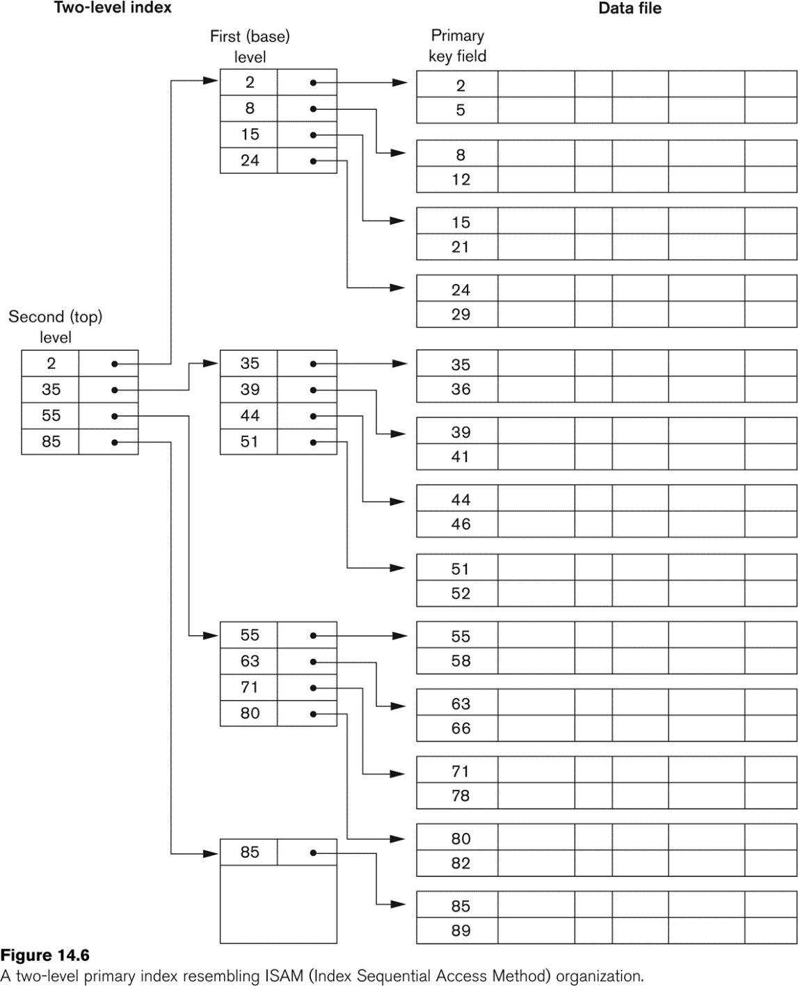
A Two-level Primary Index

Slide 46
Estimating Costs
For simplicity we estimate the cost of an operation by counting the number of blocks that are read or written to disk.
We ignore the possibility of blocked access which could significantly lower the cost of I/O.
We assume that each relation is stored in a separate file with B blocks and R records per block.

Slide 47
Choosing Indexing Technique
Five Factors involved when choosing the indexing technique:
access type
access time
insertion time
deletion time
space overhead

Slide 48
Indexing Definitions
Access type is the type of access being used.
Access time - time required to locate the data.
Insertion time - time required to insert the new data.
Deletion time - time required to delete the data.
Space overhead - the additional space occupied by the added data structure.

Slide 49
Index Evaluation Metrics
Access time for:
Equality searches – records with a specified value in an attribute
Range searches – records with an attribute value falling within a specified range.
Insertion time
Deletion time
Space overhead

Slide 50
Primary and Secondary Indices
Indices offer substantial benefits when searching for records.
BUT: Updating indices imposes overhead on database modification --when a file is modified, every index on the file must be updated,
Sequential scan using primary index is efficient, but a sequential scan using a secondary index is expensive
Each record access may fetch a new block from disk
Block fetch requires about 5 to 10 micro seconds, versus about 100 nanoseconds for memory access

Slide 51
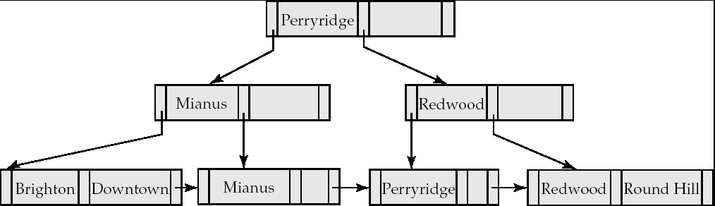
B⁺-Tree Index
A B⁺-tree is a rooted tree satisfying the following properties:
All paths from root to leaf are of the same length
Each node that is not a root or a leaf has between ⎡n/2⎤ and n children. [Non leaf node]
A leaf node has between ⎡(n–1)/2⎤ and n–1 values
Special cases:
If the root is not a leaf, it has at least 2 children.
If the root is a leaf (that is, there are no other nodes in the tree), it can have between 0 and (n–1) values.

Slide 52
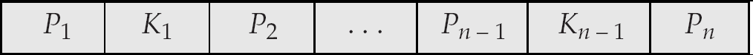
B⁺-Tree Node Structure
Typical node
K_{i} are the search-key values
P_{i} are pointers to children (for non-leaf nodes) or pointers to records or buckets of records (for leaf nodes).
The search-keys in a node are ordered
K₁ < K₂ < K₃ < . . . < K_{n–1}

Slide 53
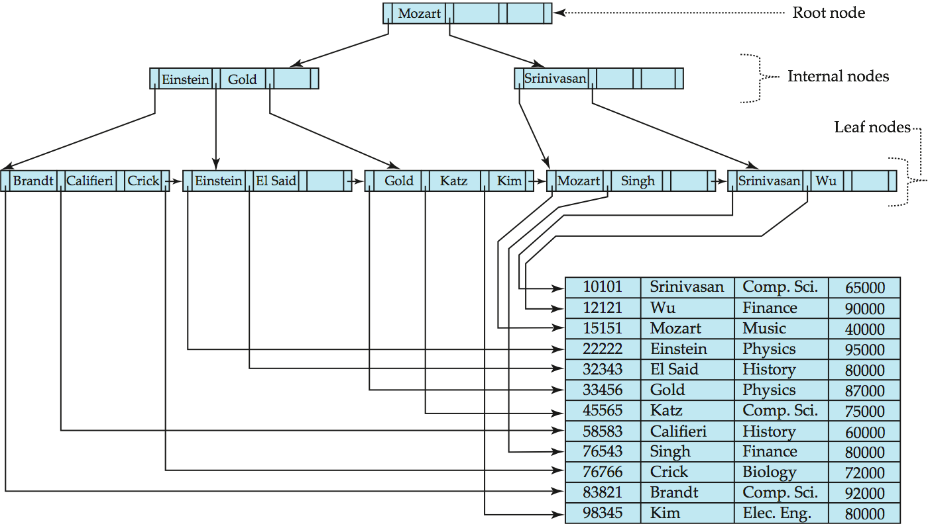
Example of B⁺-Tree

Slide 54
B+ Tree: Most Widely Used Index
Insert/delete at log _{F} N cost; keep tree height-balanced. (F = fanout, N = # leaf pages)
Minimum 50% occupancy (except for root). Each node contains n <= m <= 2n entries. The parameter n is called the order of the tree.
Supports equality and range-searches efficiently.
Index Entries
(Direct search)
Data Entries
("Sequence set")
Notes:
9

